Slide 1
Quick and (not so) Dirty: Unsupervised Selection of Justification Sentences for Multi-hop Question Answering

Slide 2
ROCC
maximizes the Relevance
minimizes the lexical Overlap
maximizes the lexical Coverage for Answer
maximizes the lexical Coverage for Question

Slide 3
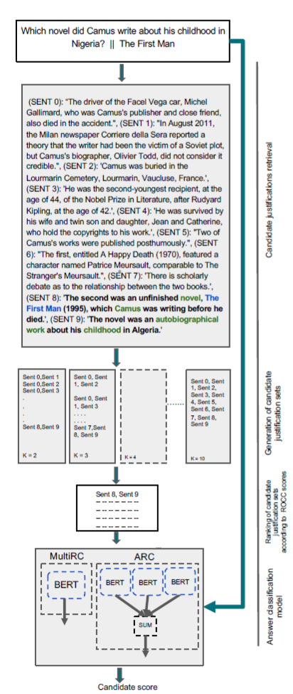
This algorithm selects justification sets instead of justification sentences.
The are generated by nCk where n is the top n results given by BERT or any other model.

Slide 4
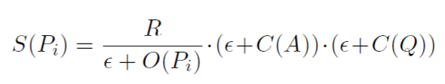
How to calculate ROCC score:
Where R is the relevance from BM25 IR model.
Overlap (O): To ensure diversity and complementarity between justification sentences, we compute the overlap between all sentence pairs in a given group. Thus, minimizing this score reduces redundancy and encourages the aggregated sentences to address different parts of the question and answer.
C(A) and C(B): Complementing the overlap score, this component measures the lexical coverage of the question and the answer texts by the given set of justifications.

Slide 5
ADVANTAGES OF ROCC:
This approach does not require any training data for justification selection. Unlike approaches that rely on structured KBs, which are expensive to create.
ROCC can be coupled with any supervised QA approach that can use the selected justification sentences as additional signal.

Slide 6
We show that the sentences selected by our method improve the performance of a state-of-the-art supervised QA model on two multi-hop QA datasets: AI2’s Reasoning Challenge (ARC) and Multi-Sentence Reading Comprehension (MultiRC). We obtain new state-of-the-art performance on both datasets among approaches that do not use external resources for training the QA system.

Slide 7
GRU’s(Gated Recurrent Unit)

Slide 8
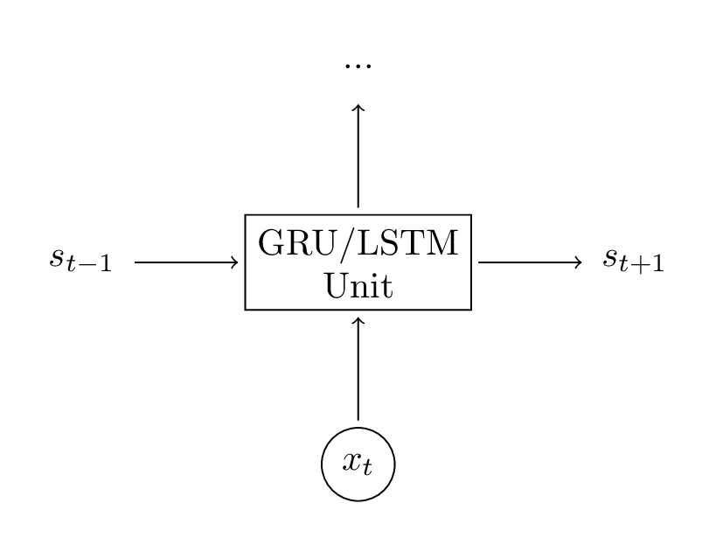
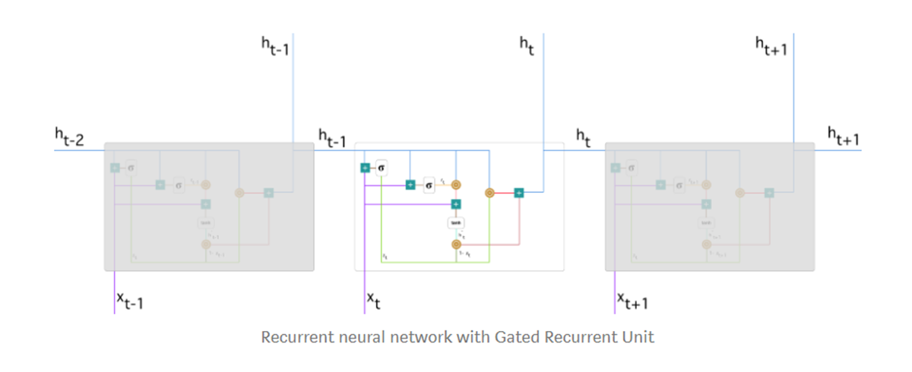
You can essentially treat LSTM (and GRU) units as a black boxes. Given the current input and previous hidden state, they compute the next hidden state in some way.

Slide 9
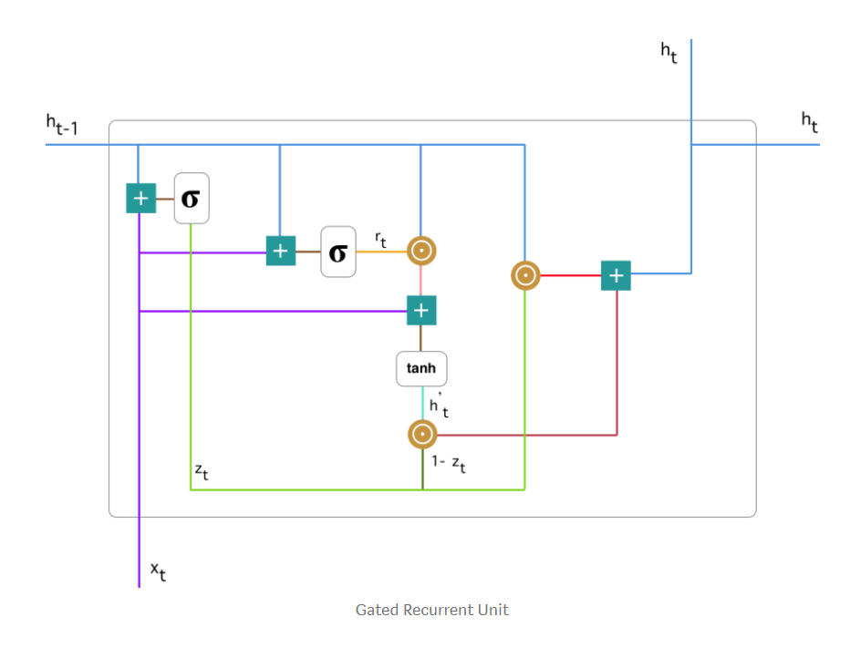
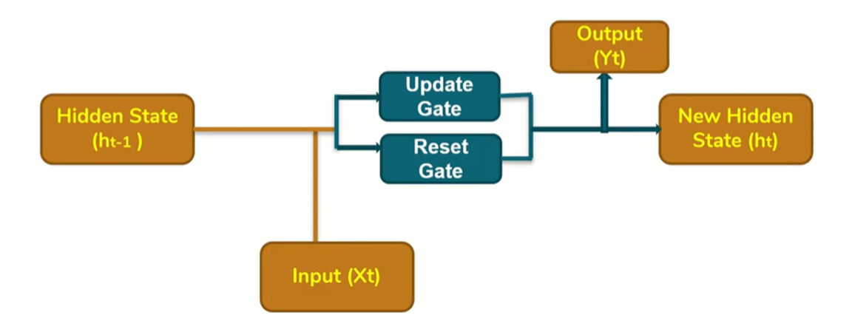
A GRU has two gates, a reset gate r, and an update gate z.
Intuitively, the reset gate determines how to combine the new input with the previous memory.
The update gate defines how much of the previous memory to keep around.
If we set the reset to all 1’s and update gate to all 0’s we again arrive at our plain RNN model.

Slide 10
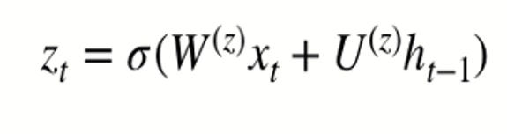
Update gate:
The major task of this gate is to tell the model about “How much of the past information needs to be maintained”
Represented by Zt
Input represented by Xt , previous ht-1 state information multiplied with respective weights and parameters
Sigmoid activation is used for Zt

Slide 11
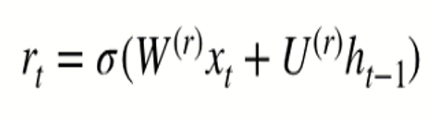
Reset gate:
The reset gate determines how to combine past information with the new input and how much of the past information to forget
Represented by Rt
Input represented by Xt , previous ht-1 state information multiplied with respective weights and parameters(different from the ones in update gate)
Sigmoid activation is used for Rt

Slide 12

Current memory component:
The process of calculating the Current Memory Gate is a little different. First, the product of the Reset Gate and the previous hidden state vector is calculated. Then this vector is parameterized and then added to the parameterized current input vector.
This uses a Tanh activation function.
This drops all the unnecessary information and passes the rest along,

Slide 13
New hidden state:
Here the update gate is utilized .
To calculate the current hidden state, first a vector of ones and the same dimensions as that of the input is defined. This vector will be called ones and mathematically be denoted by 1. First calculate the product of the update gate and the previous hidden state vector. Then generate a new vector by subtracting the update gate from ones and then calculate the product of the newly generated vector with the current memory gate. Finally add the two vectors to get the current hidden state vector.

Slide 15

Hugging face library

Slide 16
The Transformers library for TensorFlow brings together the most advanced Transformers-based AI models, like Google’s BERT and XLNet, Facebook’s RoBERTa, and OpenAI’s GPT and GPT-2. It also includes Hugging Face’s DistilBERT.
In addition to bringing together top-performing AI models, the Transformers library has an abstraction layer for each model to spare developers the time needed to integrate the model into their products or rebuild integration when a popular new model emerges.
Transformers is based around the concept of pre-trained transformer models. These transformer models come in different shapes, sizes, and architectures and have their own ways of accepting input data: via tokenization.

Slide 17
High performance on NLU and NLG tasks
Low barrier to entry for educators and practitioners
State-of-the-art NLP for everyone
Deep learning researchers
Hands-on practitioners
AI/ML/NLP teachers and educators
Lower compute costs, smaller carbon footprint
Researchers can share trained models instead of always retraining
Practitioners can reduce compute time and production costs
Dozens of architectures with over 1,000 pretrained models, some in more than 100 languages
Choose the right framework for every part of a model's lifetime
Train state-of-the-art models in 3 lines of code
Deep interoperability between TensorFlow 2.0 and PyTorch models
Move a single model between TF2.0/PyTorch frameworks at will
Seamlessly pick the right framework for training, evaluation, production

